Slide 1
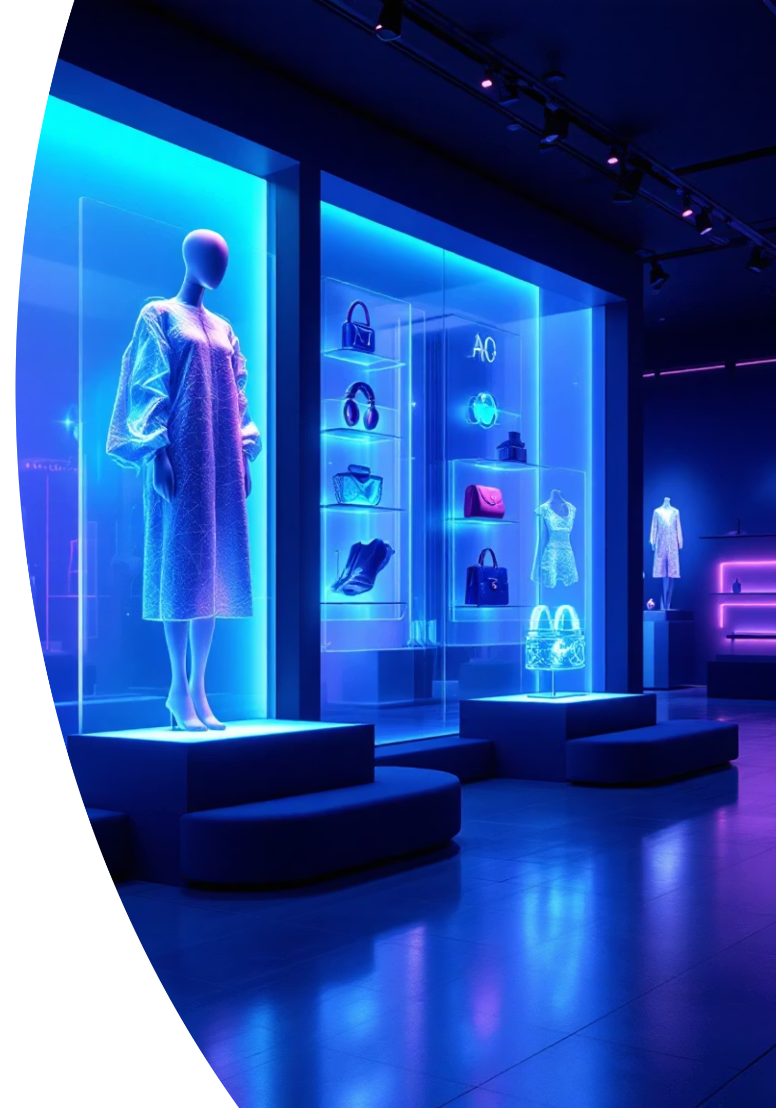
TRYON
Hacking the Billion Dollars "Expectation vs. Reality" Gap
Team Raw | HackerWrath - Track 4: Hack the System

Slide 2
Meet the Team
Innovative technologists tackling the broken e-commerce returns system.
Kartik Rehan
Manmohit Singh
Team Lead / Frontend & System
Backend
4th Year, 2026
4th Year, 2026

Slide 3


The Broken System
The Inefficient, Wasteful, and Broken Cycle of E-commerce Returns
Online Purchase
Unmet Expectation
Customer Return
Landfill Waste

Slide 4
The Billion Dollar Problem
The Financial Impact Retailers Face Daily
30-40%
£7B
$38B
Average Return Rate
Annual UK Cost
US Returns Value
Online fashion returns. A systemic crisis.
Apparel returns burden on retailers (2022).
Estimated online apparel returns (2023).
Sources: HSBC, Economic Times, British Fashion Council, Coresight Research

Slide 5

The Expectation vs. Reality Gap
Why Customers Return
53% of returns are due to size and fit issues—but the real driver is stylistic uncertainty.
Customers are gambling on two critical questions:
"Will this fit?"
"Will this actually look good on me?"
This uncertainty drives "bracketing": buying multiple items just to try different styles at home.

Slide 6

The Environmental Catastrophe
What Retailers Never Talk About: The True Cost of Returns
23M
750K
UK Landfill Bound
Tonnes CO2 Emissions
Returned garments sent to landfills or incinerated annually (2022).
From UK returns processing annually. A planetary emergency.
Sources: HSBC, ScienceDirect

Slide 7
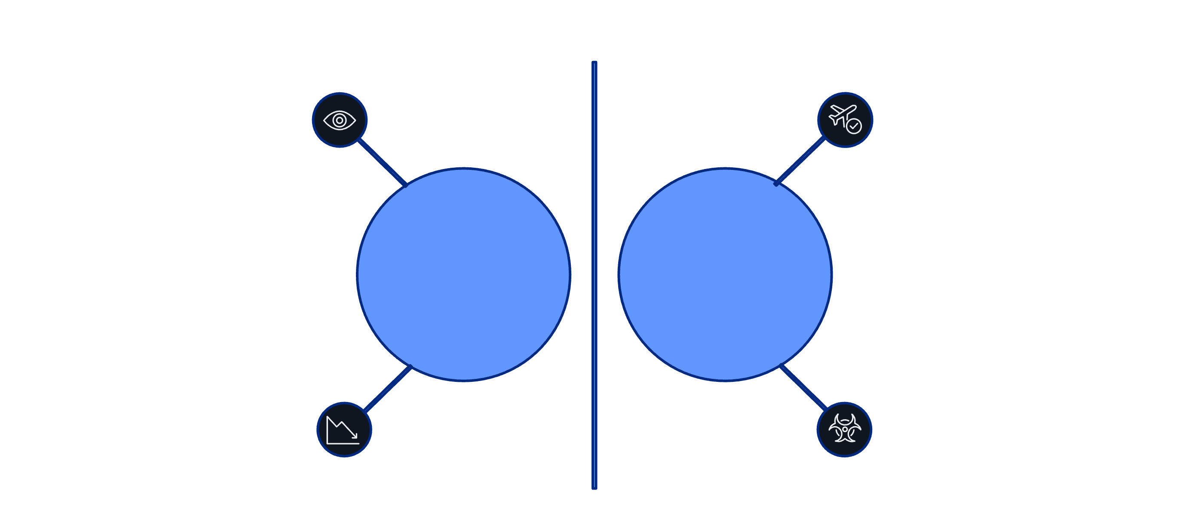


Our Solution: Hacking the System
We stop the return before it happens. tryon gives customers confidence through virtual try-ons and AI-powered style guidance.
Customer sees item
Confident purchase ✓
Fixed Flow
Broken System
AR Try-On + AI Stylist
Uncertain choice → return
By replacing uncertainty with confidence, we eliminate the root cause of returns—stylistic doubt.

Slide 8



How It Works
Three core innovations powering tryon's competitive advantage.
AR
AI Stylist
Seamless Integration
Lens Studio renders clothes, watches, jewelry, and shoes at true scale with photorealistic precision.
Gemini AI analyzes your virtual try-on and delivers instant, personalized style feedback and recommendations in real-time.
Built with Flutter (iOS/Android) and Node.js backend for fast, scalable performance across platforms.

Slide 9
Innovation & Hackathon Delivery
Our Core Innovation
Completed for HackerWrath
We're not just a virtual mirror. We're a virtual mirror with an AI stylist—an AR + AI combination that's a first. This directly solves the "Will this look good on me?" problem that drives millions of returns.
Flutter App: Core UI and AR integration complete
Node.js API: Live endpoint serving 10 demo products
Lens Studio: 3 high-quality AR assets created
Gemini AI: Live API calls for real-time style recommendations

Slide 10
Challenges & Future Scope
Immediate Challenges
Future Scope
3D Asset Pipeline: Scaling efficient 3D model creation from product images
AI-Powered Sizing: Integrate body measurement tools to solve the 53% fit problem
AI Fashion Nuance: Training Gemini to understand complex, context-dependent style rules
GenAI Asset Creation: Use generative AI to create 3D models from 2D product photos
Performance Optimization: Ensuring AR rendering stays smooth across device tiers
Plug-and-Play Integration: Full APIs for Shopify, Magento, WooCommerce, and major retailers
Multi-User Collaboration: Friends rating virtual try-ons in real-time

Slide 11
We Fixed the System
By replacing uncertainty with confidence, we:
Empower Customers: Ending the 'buy-and-return' gamble.
Save Retailers Billions: Tackling the £7bn problem.
Protect the Planet: Diverting millions of items from landfills.

Slide 12
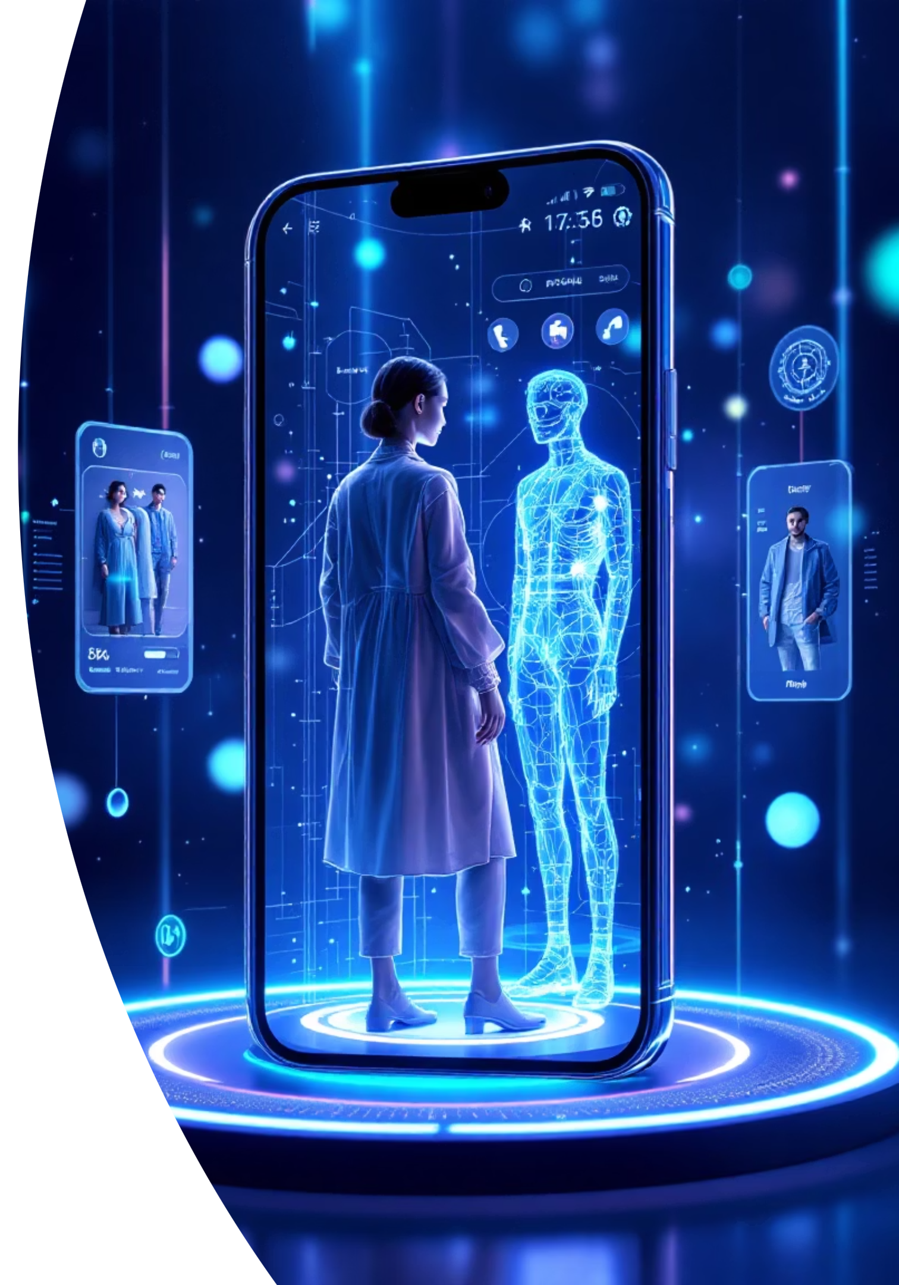
Thank You & Demo
We'd now like to show you our AI Stylist in action.
Contact: kartik30rehan@gmail.com

